Slide 1


ASSIGNMENT FOR A POSITION AS HARDWARE ASIC ENGINEER AT
E.ON FUTURE LAB
Gergely Levai
03.08.2023

Slide 2
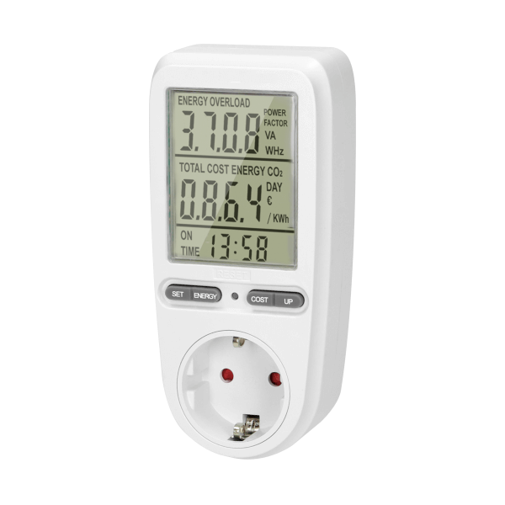
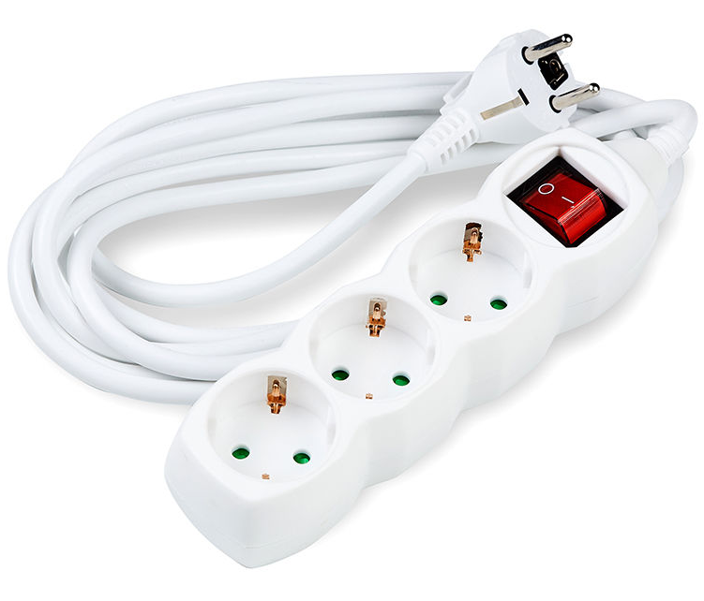
Smart Power Meter
Current State of Technology and Improvement Areas
Single usecase
Low UX
Limited connectivity
Not practical
Multi-purpose
High UX
Smart device
Modular
E.ON Future Lab
Gergely Levai
03.08.2023

Slide 3
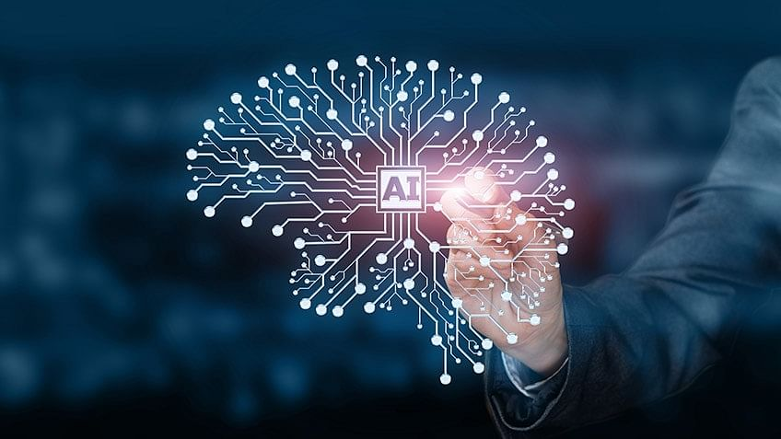
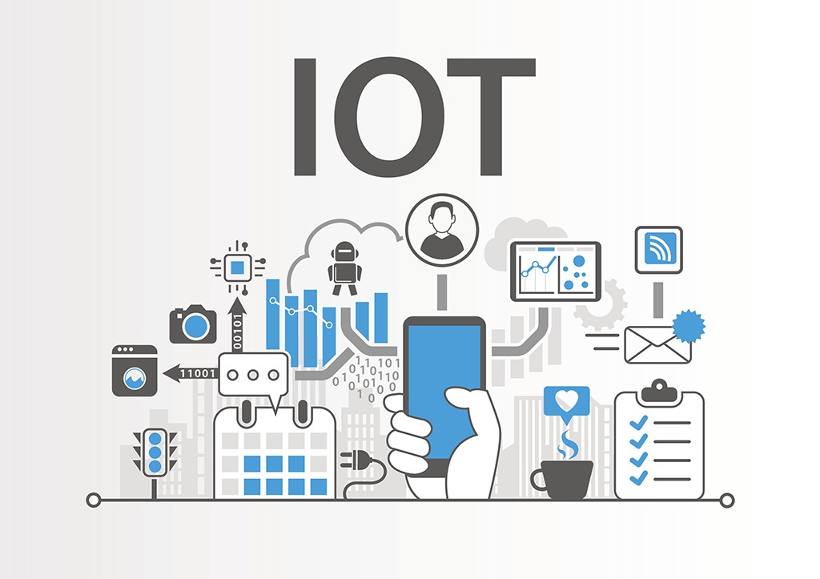
Smart Power Meter
Current State of Technology and Improvement Areas
Data Processing and Connectivity
AI model with 50 parameters
Internet enabled (via standard cable)
Bluetooth connection to other smart devices
E.ON Future Lab
Gergely Levai
03.08.2023

Slide 4


Smart Power Meter
Current State of Technology and Improvement Areas
Cybersecurity
Connected Smart device
State of the art Cybersecurity using SmartCard and HSM signing
256 bit AES encryption of data with unique keys for each unit
STM32HSM firmware
E.ON Future Lab
Gergely Levai
03.08.2023

Slide 5

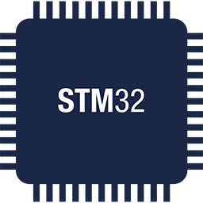

Smart Power Meter
Mains Connection
(~230V-50Hz/~115V-60Hz)
Power and Processing
Communication
Cloud
Power Supply
Microprocessor
Power Source
A
Other Appliances
APP
TV
Current Signal
E.ON Future Lab
Gergely Levai
03.08.2023

Slide 6
Smart Power Meter
Simplified System Design
X4
Transformator + Regulators
+3.3V
uC
STM32U545
+3.3V
X2
RYBG211
+5V
AC IN
(To Socket)
UART
Bluetooth
Data In/Out
To Appliances
+3.3V
GND
GND
Reset
NRST
X1
+3.3V
ENC28J60
SPI
Ethernet
Data In/Out
(RJ45 to Router)
X3
Current sensor
+5V
AC OUT
(To Appliances)
Voltage
GND
Voltage
GND
GND
E.ON Future Lab
Gergely Levai
03.08.2023

Slide 7
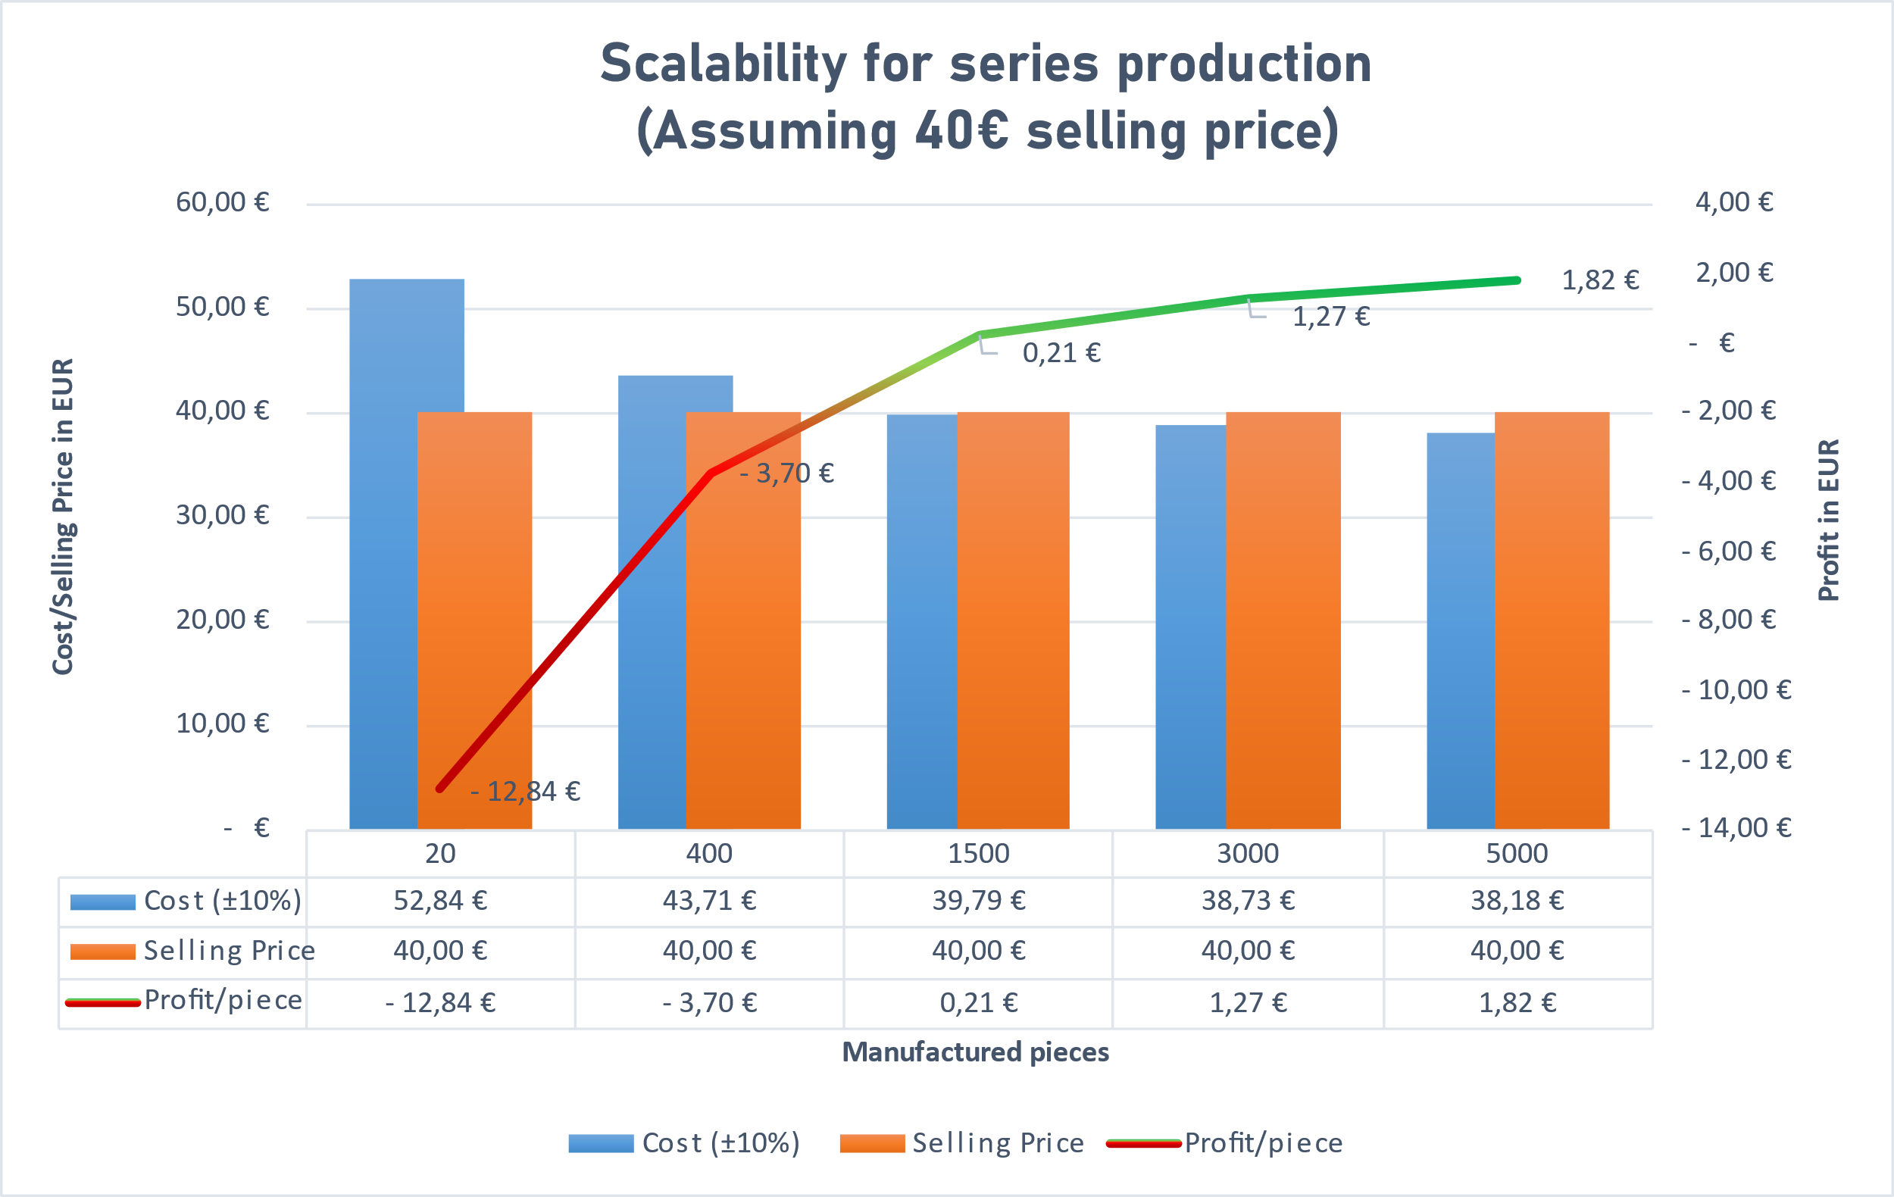
Smart Power Meter
Price and Scalability Study
Prices calculated from multiple vendors looking for best price/quality ratio
PCB price assumed with population, can be further reduced by investing in a population machine
Break-even point at 1500 pcs.
E.ON Future Lab
Gergely Levai
03.08.2023

Slide 8

Thank you for your attention!

